Slide 1

E Parking
Team Members
19K45A05A8 – P. Rithika Reddy
19K41A05B1 – S. Shiva Keerthi
19K41A05B0 – Ramsha Mehreen

Slide 2

Contents
Overview of the Project
Existing System
Proposed System
Block Diagram
Results
Conclusion

Slide 3

Overview of the Project
We aim to develop an online parking system to replace the existing manual system of parking the vehicles.
We aim to develop an online parking system such that it will be user friendly and reduce the burden for the user.
The objective of our project is to digitalize the existing manual approach to park the vehicles.

Slide 4

Existing System
The users need to wait in a queue to get registered and get assigned to a slot.
It becomes a tedious task to the user to go through all this process.

Slide 5

Proposed System
We aim to develop an online parking system to view and park the vehicles in the slot desired by the user.
In this application the user can also change their slot if they want.

Slide 6
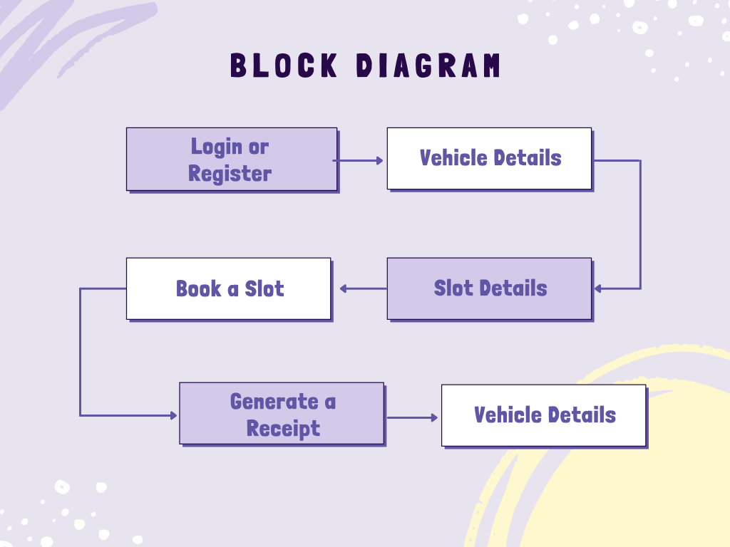
Block Diagram

Slide 7

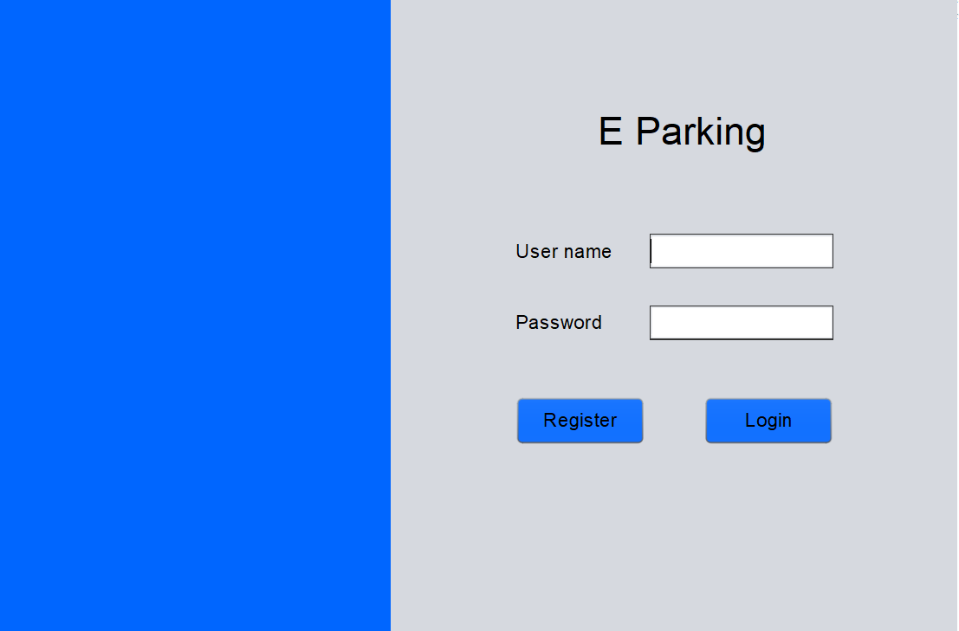
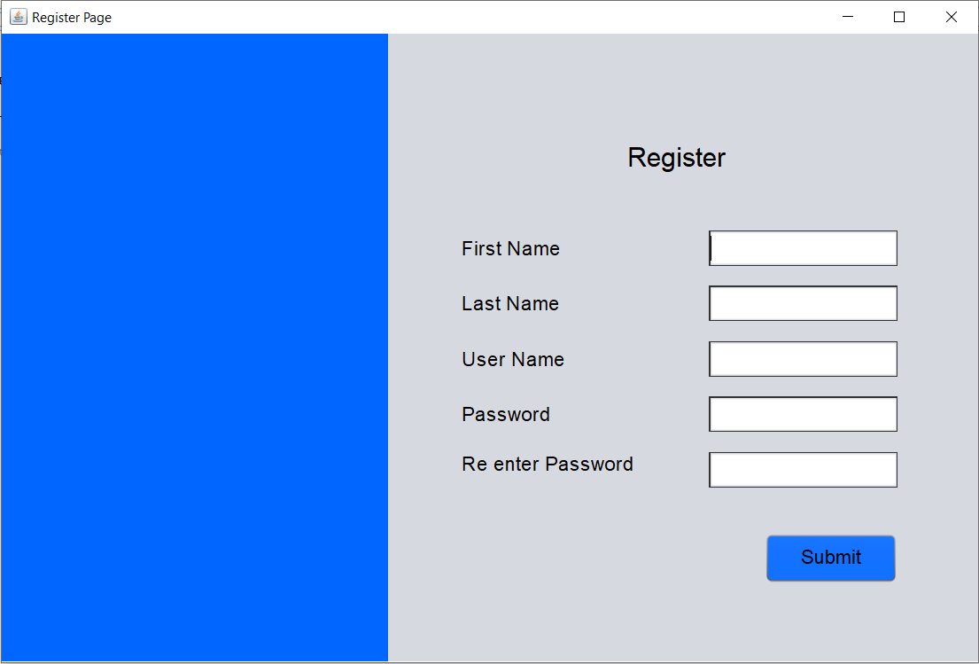
Results

Slide 8

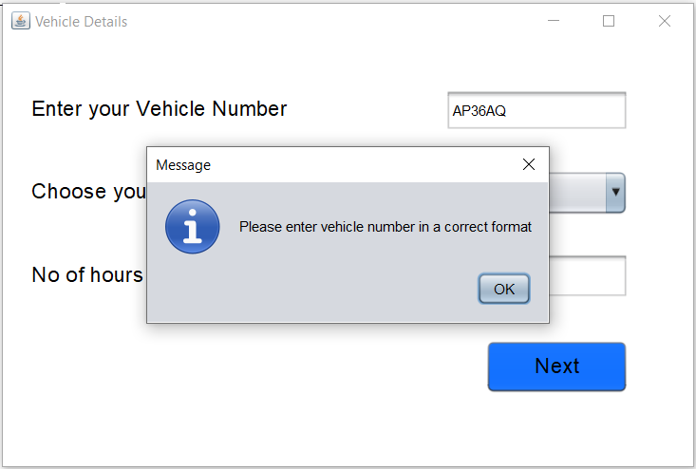
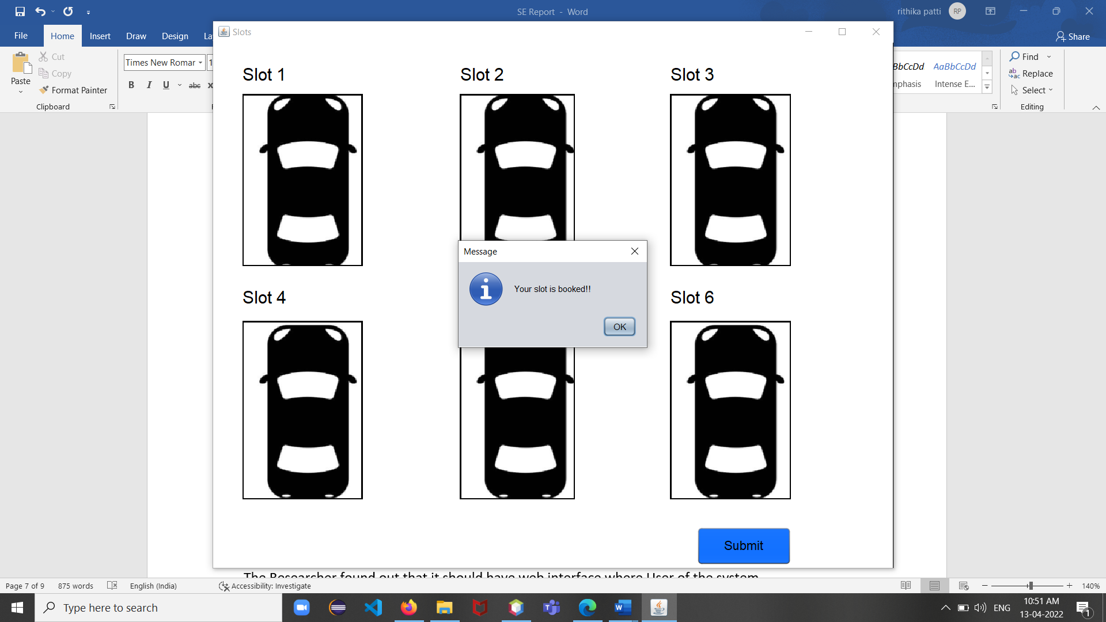

Slide 9
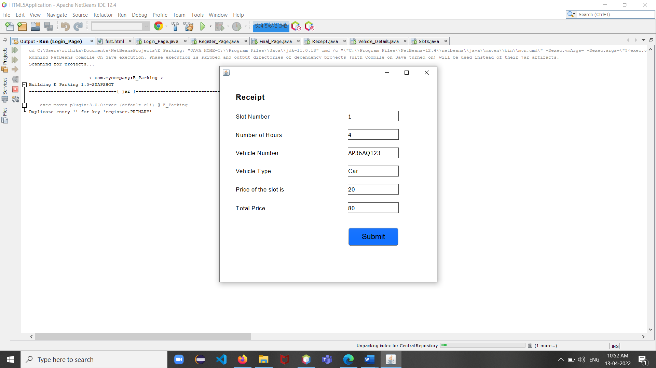
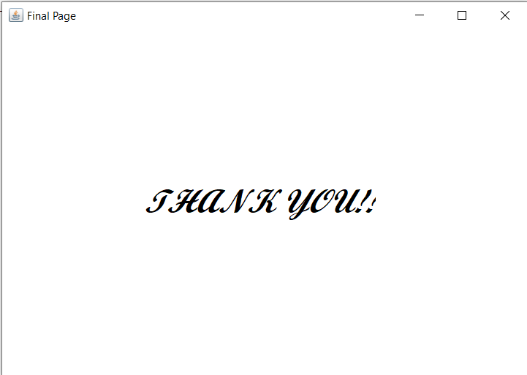

Slide 10
Conclusion
In short, we have developed an application to book the parking slots in online mode.
So, that it would be handy to the user to book the slot easily.

Slide 11


